Slide 1

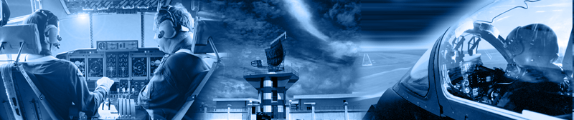

A320 FFS
Maintenance Technicians
Training Course
Motion and Controls
- Hydraulic Power Unit
- Control System
Prepared By: Mohamed Sakr
Thales Training & Simulation
Notes:
3 IO System Part 1
9-Aug-99
Robbie Young Instructor Notes TTSL Prod Training Department

Slide 2
A320 FFS
Maintenance Technicians
Training Course
Prepared By: Mohamed Sakr
HYDRAULIC POWER UNIT
Thales Training & Simulation
Notes:
3 IO System Part 1
9-Aug-99
Robbie Young Instructor Notes TTSL Prod Training Department

Slide 3
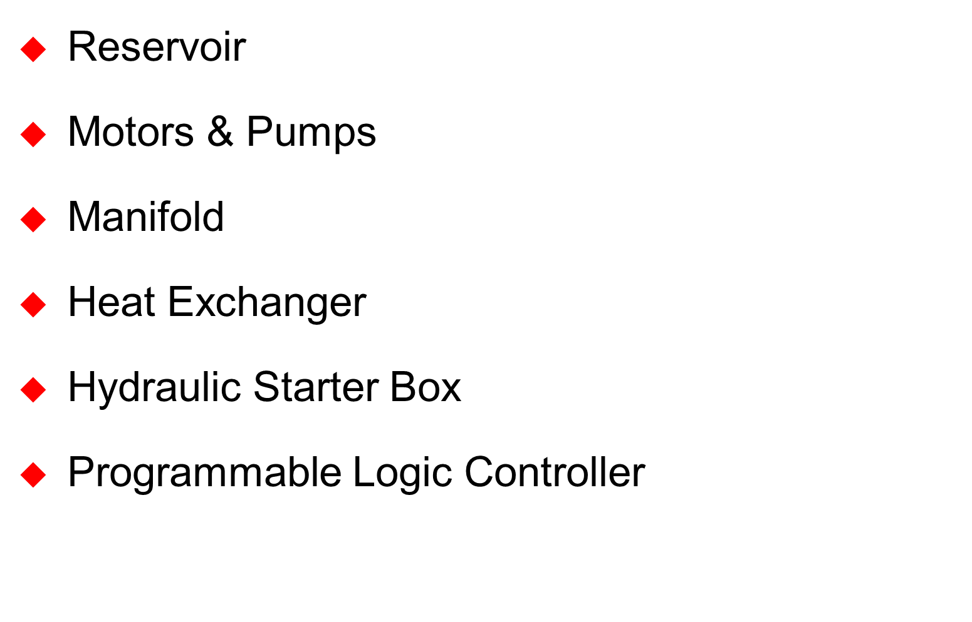
HYDRAULIC POWER UNIT ROOM :-

Slide 4
1. Reservoir
  2000 litres (440 gals)
2. Motion Pumps & Motors
  2 Variable Displacement Piston Pumps driven by 55KW induction motors
3. Drawbridge (CL) Pump & Motor
  1 Variable Displacement Piston Pump driven by a 7.5KW three phase motor
4. Cooling Pump & Motor
  1 Fixed vane pump driven by a 4KW three phase motor

Slide 5
5. Heat Exchanger
  Heat Exchanger Water cooled
  Oil is circulated by cooling pump
6. Hydraulic Starter Box
  Supplied by Mannesman Rexroth
7. Programmable Logic Controller
  FIP Bus

Slide 6
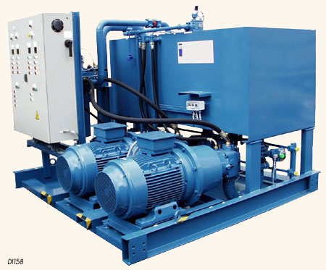
HPU Photo
RETURN LINES
HYDRAULIC
STARTER
Box
MOTION PUMP 1
2000 LITERS OIL RESERVOR
MOTION PUMP 2
TEMPERATURE SENSING
Notes:
3 IO System Part 1
9-Aug-99
Robbie Young Instructor Notes TTSL Prod Training Department

Slide 7
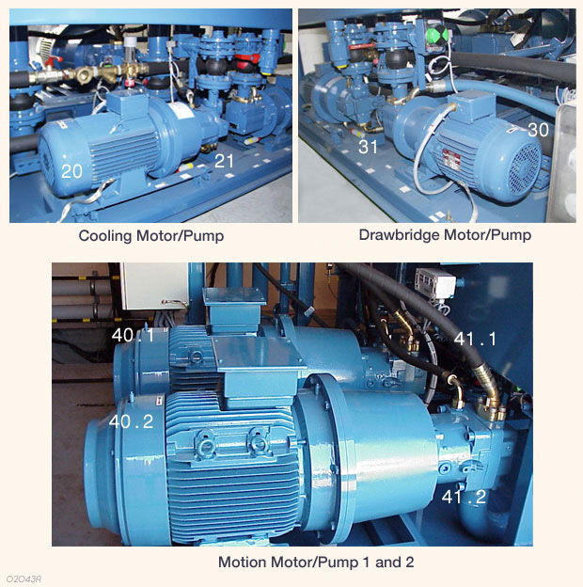
Motors & Pumps
  Motion
    55 KW induction motor driving variable piston pumps to give 140 bar
  Drawbridge
    7.5 KW 3-phase motor driving variable piston pumps to give 130 bar
  Cooling
    4 KW 3-phase motor driving fixed vane pump to give2.8 bar
Drawbridge Motor/Pump
Cooling Motor/Pump

Slide 8
Hydraulic Power Unit - Front
55KWatt induction motor driving variable
piston pumps to give 120 bar oil pressure
Cooling Pump
Motion Pump 1
120 Bar
Motion Pump 2
115 Bar
4 KWatt 3-phase motor driving fixed
vane pump with 2.8 bar oil pressure
Notes:
3 IO System Part 1
9-Aug-99
Robbie Young Instructor Notes TTSL Prod Training Department

Slide 9
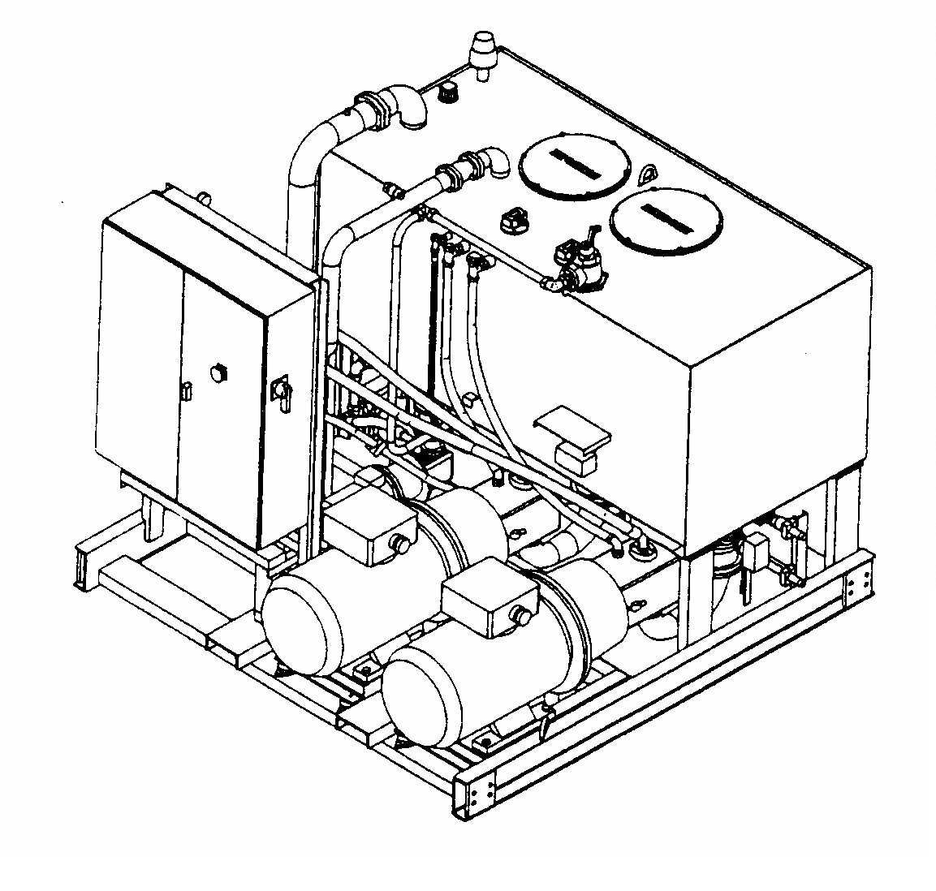
Hydraulic Power Unit - 1
Hydraulic
Starter Box
Temperature Sensing
Notes:
3 IO System Part 1
9-Aug-99
Robbie Young Instructor Notes TTSL Prod Training Department

Slide 10
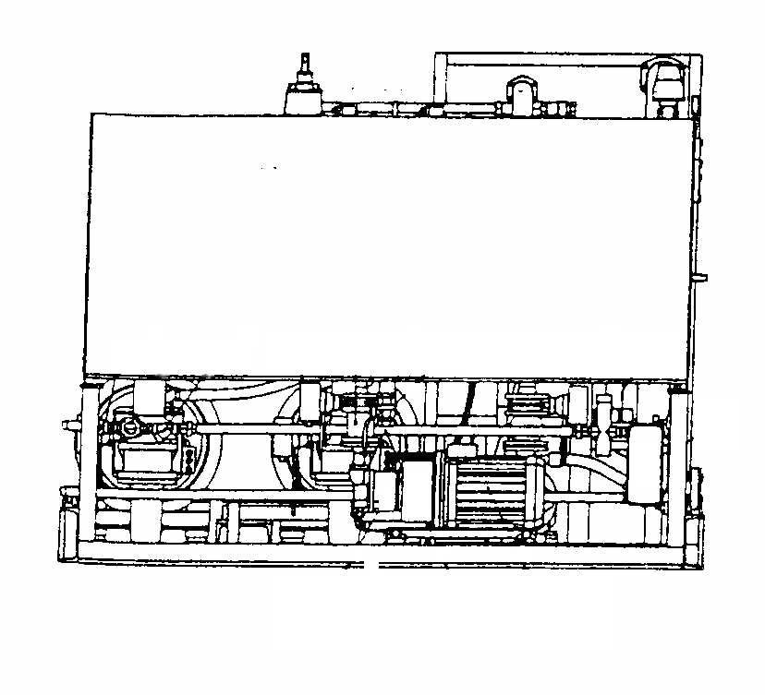
Hydraulic Power Unit - 2
Oil Reservoir (2000 litres)
7.5 KWatt 3-phase motor driving variable
piston pump to give 130 bar oil pressure
Heat
Exchanger
Drawbridge Pump
100 Bar
Cooling Pump
10 Bar
Notes:
3 IO System Part 1
9-Aug-99
Robbie Young Instructor Notes TTSL Prod Training Department

Slide 11
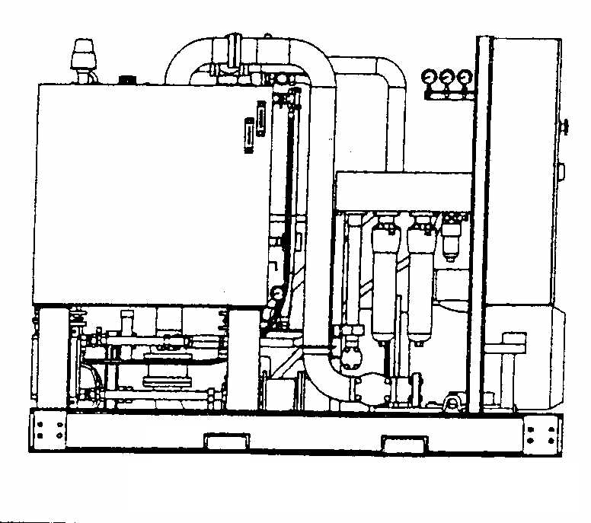
Hydraulic Power Unit - 3
Manifold
Return Line
Filters
Notes:
3 IO System Part 1
9-Aug-99
Robbie Young Instructor Notes TTSL Prod Training Department

Slide 12
CONTROL SYSTEM
Hydraulic Starter Box
Notes:
3 IO System Part 1
9-Aug-99
Robbie Young Instructor Notes TTSL Prod Training Department

Slide 13
Hydraulic Starter Box
POWER ON
WARNING (START IN PROGRESS)
V0
V20
SAFETY ISOLATOR
CONTROL
HYDRAULIC OFF
ISOLATED
ON
LOCAL
REMOTE
AU
.
C1
C2
PUMP 1
PUMP 2
COOLING
CONTROL
LOADING
TIME COUNTER
TIME COUNTER
TIME COUNTER
TIME COUNTER
T1
T2
T4
T3
BP2
V3
START
BP4
V6
START
BP8
V12
BP6
V9
START
BP1
V2
START
STOP
BP3
V5
STOP
BP7
V11
STOP
BP5
V8
STOP
V13
SUCTION VALVE CLOSED
V14
SUCTION VALVE CLOSED
V16
SUCTION VALVE CLOSED
V15
SUCTION VALVE CLOSED
V1
MOTOR FAULT
V4
MOTOR FAULT
V10
MOTOR FAULT
V7
MOTOR FAULT
MOTION PRESSURE
CONTROL LOADING PRESSURE
V21
OFF
ON
V22
V24
OFF
ON
V25
C3
C4
V17
OIL LEVEL LOW
LAMP TEST
V18
OIL TEMPERTURE HIGH
RESET INDICATORS
V23
CROSSOVER VALVE OPEN
V19
PHASE FAILURE
Notes:
3 IO System Part 1
9-Aug-99
Robbie Young Instructor Notes TTSL Prod Training Department

Slide 14
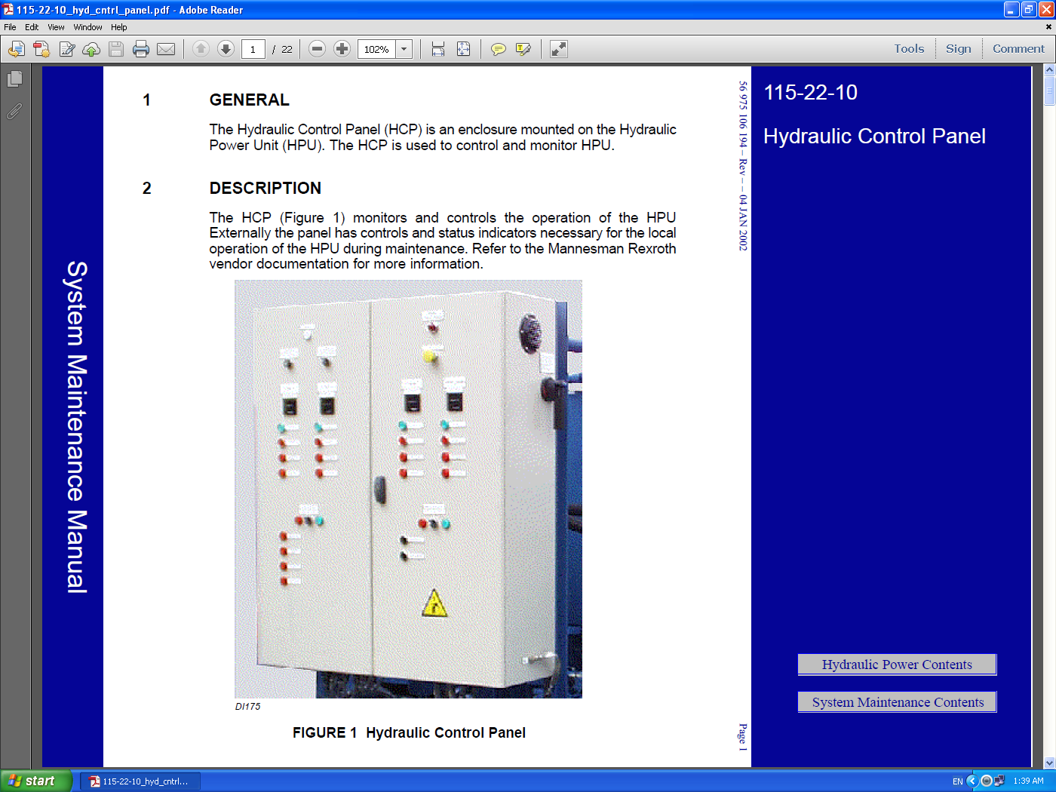

Slide 15
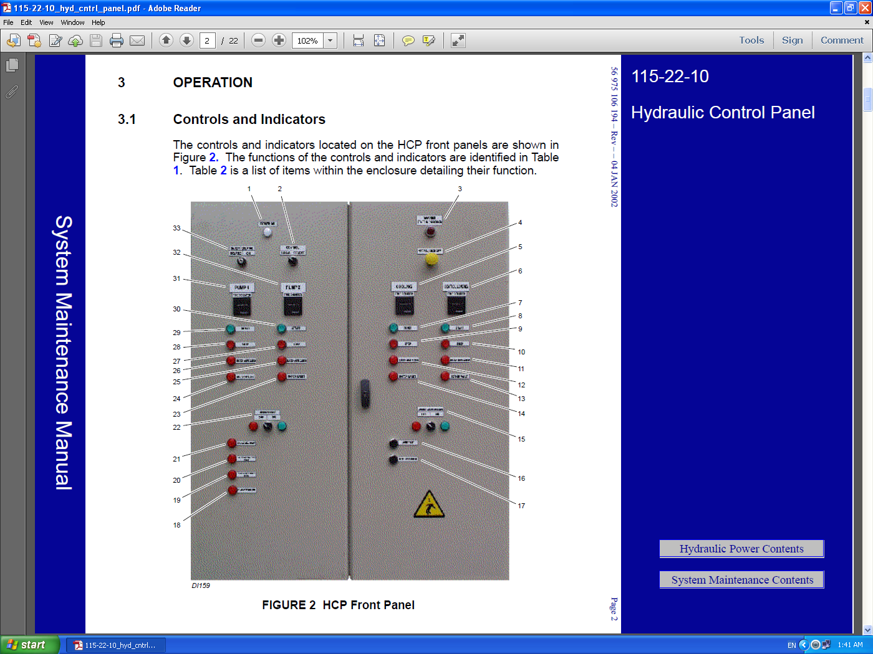

Slide 16
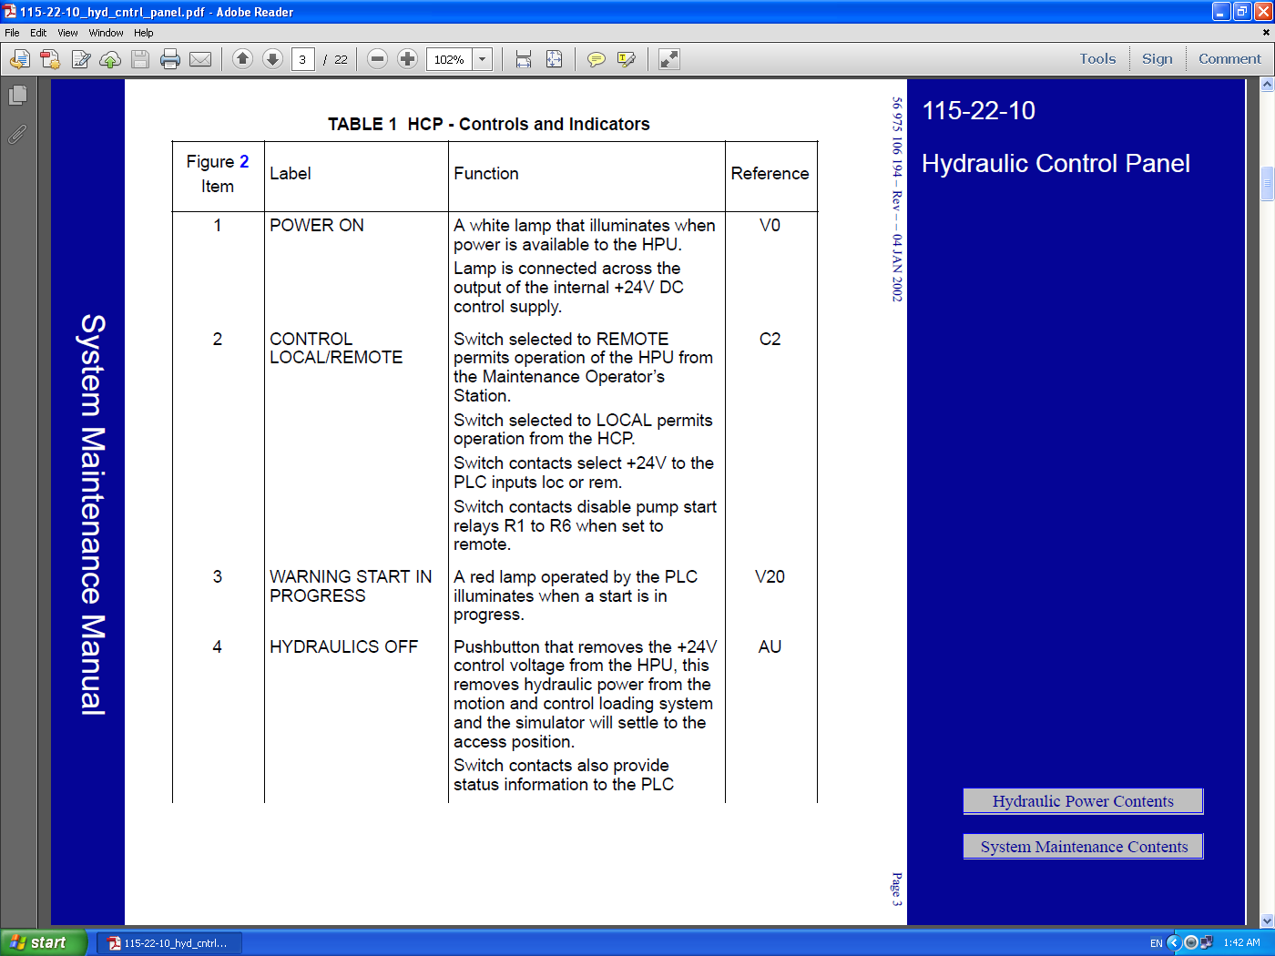

Slide 17
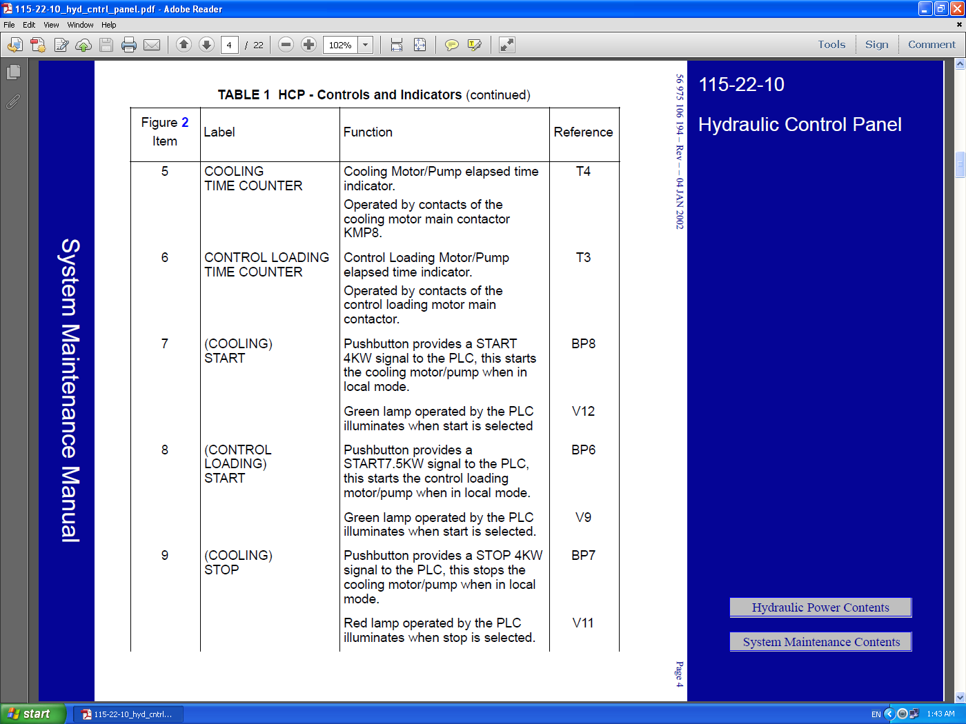

Slide 18
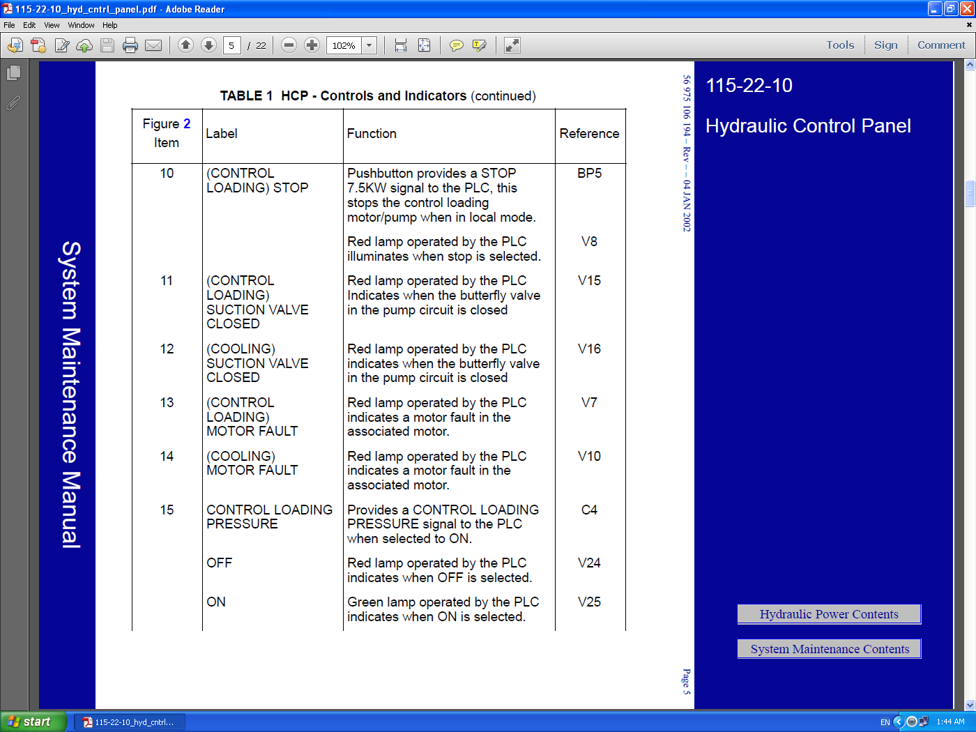

Slide 19
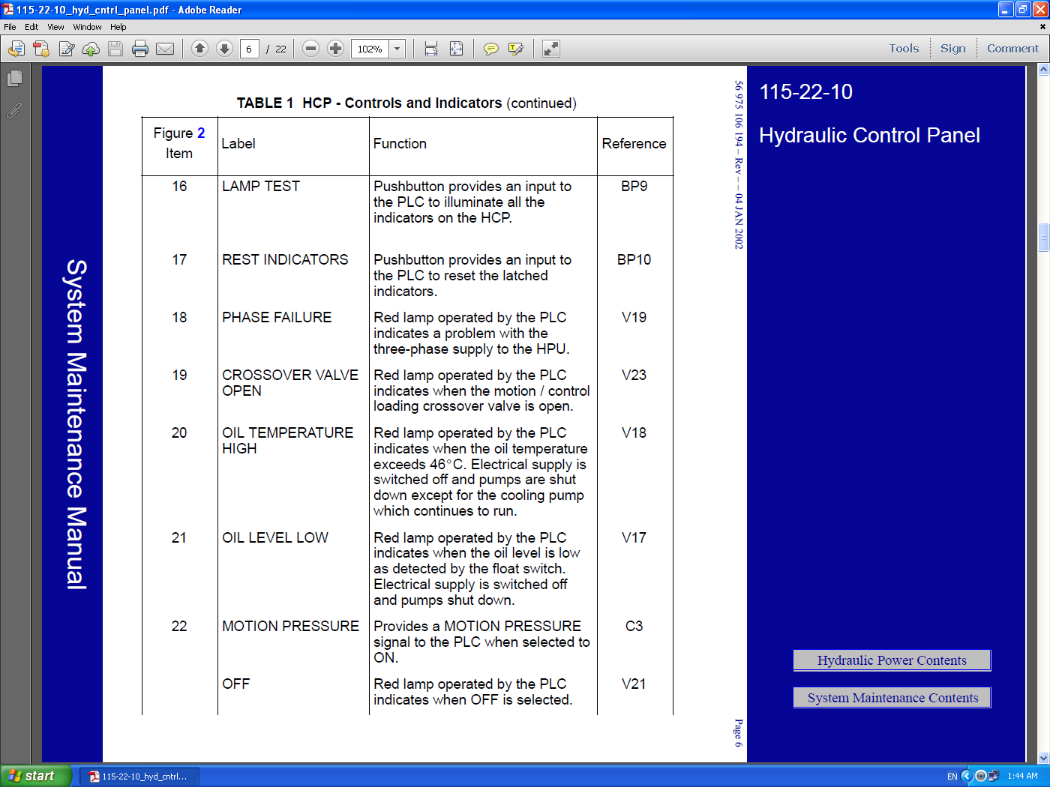

Slide 20


Slide 21
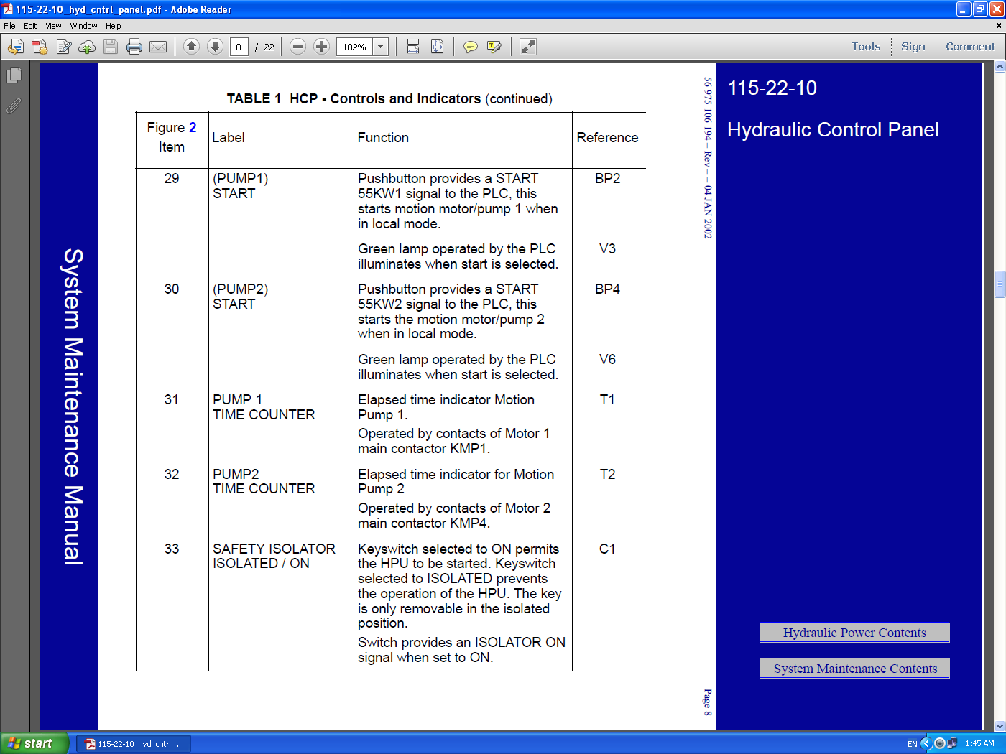

Slide 22

Disposal Regulation
Hydraulic Oil
must be disposed
In Accordance With
Local
Environmental
Regulations

Slide 23


References : THALES STD simulator Manufacture manual .
?
Please Feel free to Ask

